Slide 1
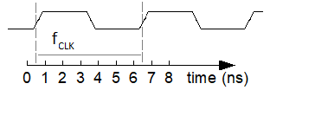
Esercizio:
Supponendo t_{cd} = t_{pd}
Calcolare la frequenza del segnale CLK
CLK

Slide 2
Book exercises

Slide 3
Book exercises

Slide 4
Book exercise
Exercise 3.20 You are designing an FSM to keep track of the mood of four
students working in the digital design lab. Each student’s mood is either HAPPY
(the circuit works), SAD (the circuit blew up), BUSY (working on the circuit),
CLUELESS (confused about the circuit), or ASLEEP (face down on the circuit
board). How many states does the FSM have? What is the minimum number of
bits necessary to represent these states?

Slide 5
Book exercise
Exercise 3.22 Complete a state transition table and output table for the FSM in Figure 3.69. Write Boolean equations for the next state and output and sketch a schematic of the FSM.

Slide 6
Book exercise
Exercise 3.24
Extend the light controller described during the last lesson so that both lights are red for 5 seconds before either light turns green again. Sketch your improved Moore machine state transition diagram, state encodings, state transition table, output table, next state and output equations, and your FSM schematic.

Slide 7
Book exercise
Exercise 3.26
You have been enlisted to design a soda machine dispenser for your department lounge. Sodas cost only 25 cents. The machine accepts nickels (5 cents), dimes (10 cents), and quarters (25 cents). When enough coins have been inserted, it dispenses the soda and returns any necessary change. Design an FSM controller for the soda machine. The FSM inputs are Nickel, Dime, and Quarter, indicating which coin was inserted. Assume that exactly one coin is inserted on each cycle. The outputs are Dispense, ReturnNickel, ReturnDime, and ReturnTwoDimes. When the FSM reaches 25 cents, it asserts Dispense and the necessary Return outputs required to deliver the appropriate change. Then it should be ready to start accepting coins for another soda.

